Slide 1
Rochester Institute of Technology, 4/13/2023
Workflow Automation in the Graphic Arts Industry
CIP4
Definitions
Metadata
Process-Resource Model
(X)JDF/(X)JMF, PrintTalk
Thomas Hoffmann-Walbeck
Notes:
Background information on the underlying technology
CIP4 plays an important role
Definitions are an academic tradition: Workflow, Workflow Automation, Process, Metadata…
Focus is modelling of production
JDF and XJDF
If time allows: Print4.0

Slide 2
CIP4
International Cooperation for the Integration of Processes in Prepress, Press and Postpress
not-for-profit standards specification association
Metadata/job tickets: They specify products and production details for automatic production and business workflows
JDF/JMF, XJDF/XJMF, PrintTalk and PPF
Specifications, programming libraries, tools, case studies and marketing material can be used by everybody without paying royalties
over 1,600 individuals from approximately 300 members from 31 countries
Voluntary work
http://www.cip4.org/
https://confluence.cip4.org
Notes:
Link1: Link to CIP4.org (reminder)
Link2: Link to CIP4 case studies, https://cip4.org/casestudies.html
Link3: Confluence (reminder). Goto downloading specifications and tools, workgroups
Link4: video with Rainer Prosi about “Workflow Automation”

Slide 3
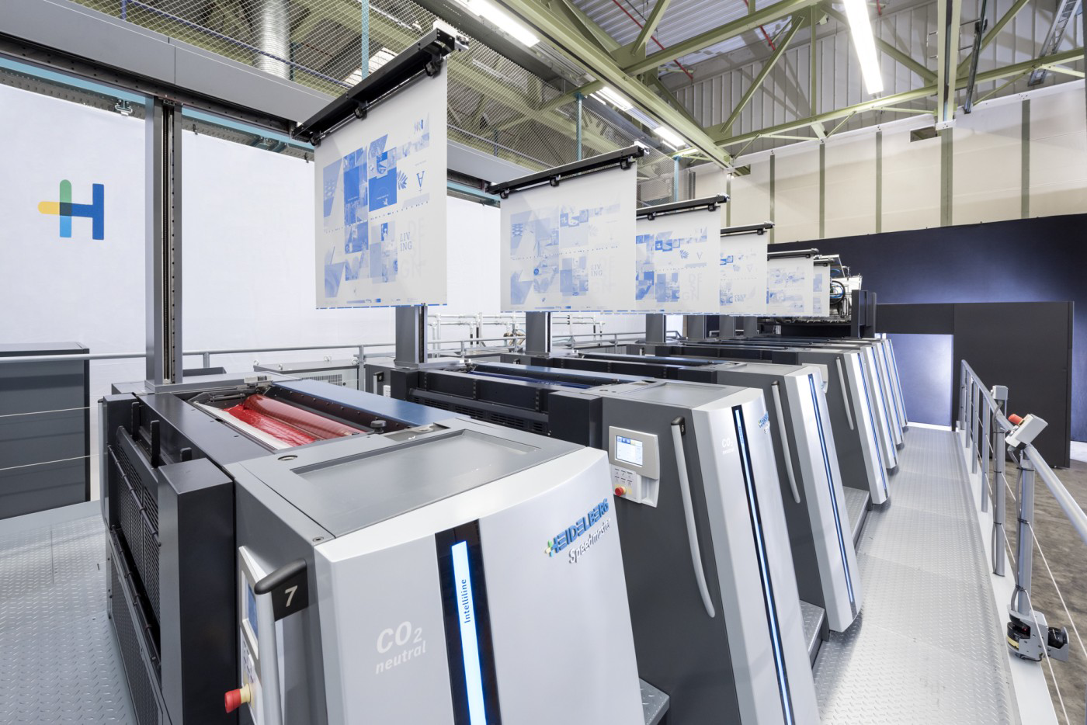
Example for Device/Machine Automation
Notes:
Automation in the Graphic Industry: normally something like what is shown in the picture
Instead of “ machine automation" one should talk about “device automation” or even about "process automation". Why? Production processes do not necessarily need machines (such as most prepress processes, e.g., imposition) and some machines cover more than 1 process (such as saddle stitcher: collecting and stitching; or a newspaper press; or a digital press)

Slide 4
Automation in Graphic Arts Industry
This lecture covers only:
Workflow Automation
-
Device Automation
Workflow and device automation depend on each other. Often device automation needs (meta) data from outside; workflow messages provide this data
Notes:
What is Workflow Automation? Two concepts
1. Workflow Automation: machines and software applications communicate via network. They share product and production details.
2. Device Automation: That is, a single process is automated like printing. For example, an automatic register control system on a press falls into this category.
The overall goal is executing production processes without human interaction.
The two types of automations are interweaved. To automate a machine often information from outside is needed. For example, a press needs to know details about the printing substrate, if a more automatic setup is striven for.

Slide 5
Print Production Workflow Automation
Which information are in the packages?
Green: Product intents, information for processes
Blue: Time & material consumed, quality report, status
Color
Managing
Preflight
Image
Setting
Cutting
Folding
Just a schematic sketch!
In reality, the communication is much more dynamic
Trapping
Controller
Prepress
MIS
Controller
Postpress
Stitching
Imposition
RIPing
Printing
Packing
Trimming
Notes:
Each yellow rectangle stands for a single process. Each process is usually executed by a device, that is, the device press executes the process printing.
Each orange rectangle represent a controller
Most important controller: MIS The is responsible for defining all jobs and for their administration. It keeps track of the jobs; it supports the calculation of quotes and manages the communication between the Print Buyer and Print Provider
Green package: Information that a device needs to execute a process automatically: presetting values, commands, job information
Blue package: Feed-back
Setting et up a workflow it’s key to know what information a process needs and the outcome

Slide 6
Metadata, Devices and Controller
A device is either a software application or some machine. It initiates the execution of one or several processes. Sometimes, it refers only to the device driver for a machine
Metadata = information/data about content data (text, images, graphics, pages) or about print production
A controller routes metadata and messages in a workflow system
E.g., MIS/ERP, Workflow (Management) System
Devices and controller communicate with each other about product and production details.
C₁
D₁
D₃
D₂
Notes:
Proper definitions
Message: A brief, (almost) real-time communication between devices and controller

Slide 7
Remarks to the last animated chart
Only communication between MIS/controller and production devices are shown. Workflow, however, should cover other areas as well!
Artwork creation, procurement, logistics, business partners…
The chart suggests 3 views of workflow automation:
The network (arrows)
The information container (green and blue container)
The information inside (things inside the container)
Our main focus in (III). However, in order to read the information, one also needs to know about the structure of the container - not on an IP or HTTP level, but, for example, on the XML level if the information is coded in XML

Slide 8
Concept of Workflow Automation
A workflow denotes the sequence of production and business processes, in whole or part, during which documents, information and task descriptions are passed from one participant to another for action according to a set of procedural rules
A process is an activity with a single specific objective that can be planned and executed independently
Workflow Automation means automatically supplying processes (devices) with data
A process can start and execute automatically, if…
…the data in the “green containers” is available and relevant
…the device understands the data and can execute a process automatically using the data (device automation)
Notes:
Workflow example:
Insurance company: How to process a claim?`
Restaurant kitchen: Who is doing what?
Process
Imposition, printing
Photoshop?
Prepress?
Make-ready of press
Workflow Automation
Incoming PDF automatically sent to Preflight engine
Ink zone profile (Rip) sent to offset press, ink zone set accordingly

Slide 9
What’s in the Containers?
Green (from controller to device):
Job administration
Customer details, Job ID, production time window
Description of the requested product (in it’s finished stage)
e.g., printing substrate, page formats, binding intent, type of inks
Production issues for pre-setting devices and apps
e.g., actual printing substrate, screening type, folding positions
Queries and commands
e.g. What is the status? Update job, cancel job
Blue (from device to controller):
Time & material consumed (currently/in total), job tracking, …
Notes:
Green:
Job admin data
customer details, how to contact him or her
formal, but pretty important thing like identifier of a job
Delivery Date
Product description
Printing substrate,
page dimensions
number of pages
Colors
Binding…
Production details
Which paper to be used
What are the folding positions?
RIPing details
Query & commands
Sending a job to some device
Manipulating the input queue of the device
Querying the device about the status
Blue
Feed back
The actual status, the actual material consumption
How much time and material has been used in total for a print job

Slide 10
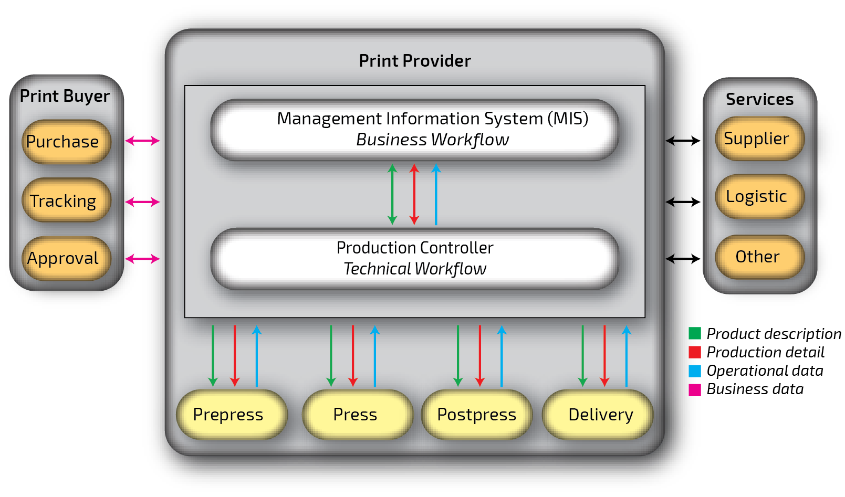
Data Exchange between PP, PB and 3rd Party
Notes:
This graphic shows in the middle the Print Provider’s internal workflow
Left: PB-PP:
The business data, that is: the quote, the purchase order, the confirmation etc.
The submission of the content data, usually PDF, but also CAD data for folding boxes
The approval processes during the production
Notifications from the print provider about the production progress.
Right: print broker, plate service provider, logistic provider or consumable supplier

Slide 11
What is Metadata in the Printing Industry?
Structured data about data (e.g., about images, PDF files) or product intent description, print production issues, operational data
Metadata can be embedded in content data or defined externally to content data (i.e. stored in a file or database)
Examples of metadata formats:
Embedded: Exif in images; XMP is in images, PDF, ID, AI, …
Not embedded: JDF/JMF, XJDF/XJMF, PrintTalk, PJTF, PPF (CIP3)
Most metadata is coded in XML or in recent times in JSON
Exceptions: Exif, PJTF, PPF
Notes:
Definition once again
Embedded or outside content data Examples?

Slide 12
Metadata – Content
Metadata often references content (print) data
Metadata in PDF: XMP, Output Intent, die cut data...
Receiver of single pages in PDF/VT (or PDF 2.0)
Product intend: ISO/CD 21812-1:2019
Reference to
<RunList Run="1" Status="Draft">
<LayoutElement>
<FileSpec MimeType="application/pdf"
URL="file://Jobs/2010-12-13/System/uebung_01.pdf"/>
</LayoutElement>
</RunList>
Extract from a sample JDF file
Notes:
Example of external metadata: JDF
Example of embedded metadata in PDF

Slide 13
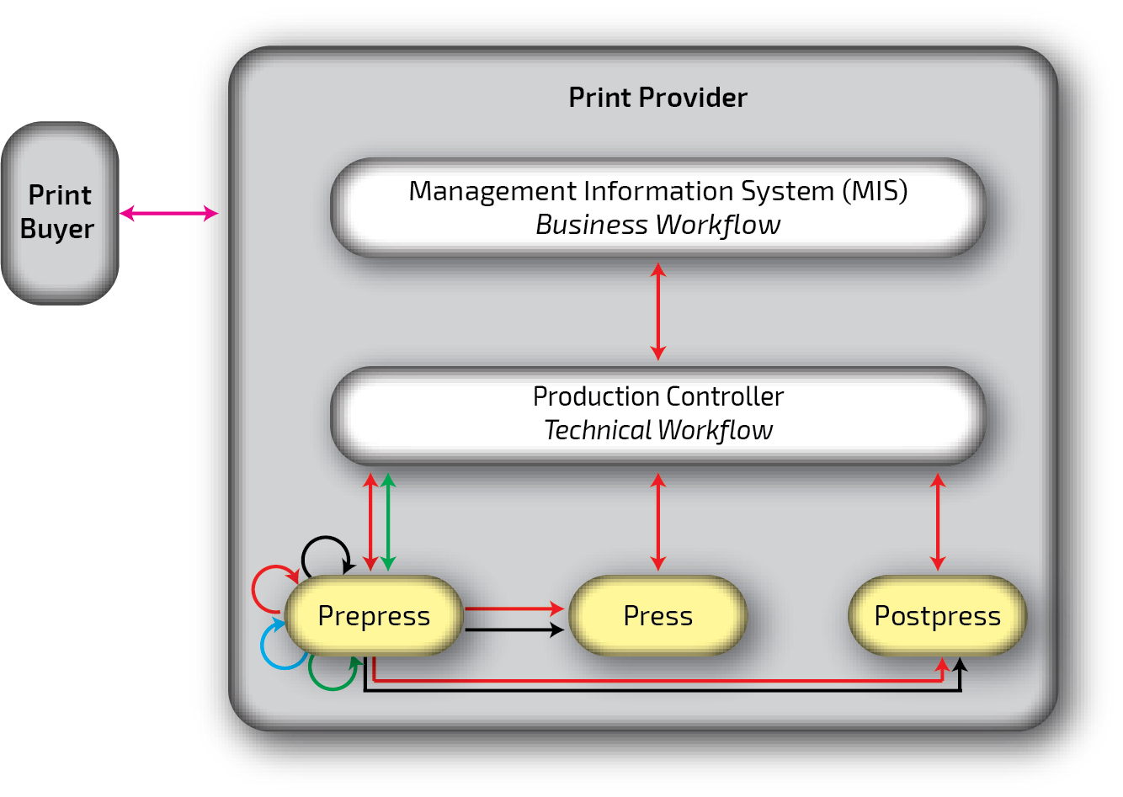
Metadata and Their Ecosystems
Often several metadata formats used in a production
Format conversions during production
e.g., Exif to XMP, XMP to JDF, XJDF to JDF, CSV to JDF,…
PPF (Print Production Format), CIP3
JDF (Job Definition Format)
XJDF (Exchange JDF)
XMP (eXtensible Metadata Platform)
EXIF (EXchangeable Image File )
PJTF (Portable Job Ticket Format)
PrintTalk
Notes:
Same chart as before
Now: Data formats
Many different formats. Reasons: Evolution and eco systems
PrintTalk includes JDF/XJDF

Slide 14
Production Models
if you want to specify a workflow - especially an automated one - you have to define the production processes and how they are connected
A universal print production “model” is needed!
Different models are available
Process list (or activity list or to-do-list): List of processes w/o execution order
Process chart: defines the order but does not define the interfaces between the processes
Flow chart
Process-Resource-Model
Notes:
Agree: We nee production models to route the print jobs
What production models comes in your mind?
List (no order!)
Ordered List or chart (no prerequisites/outcomes of processes)
Flow charts (each process and each decision represented by graphical element)
Process resource model (we study this in more detail)

Slide 15
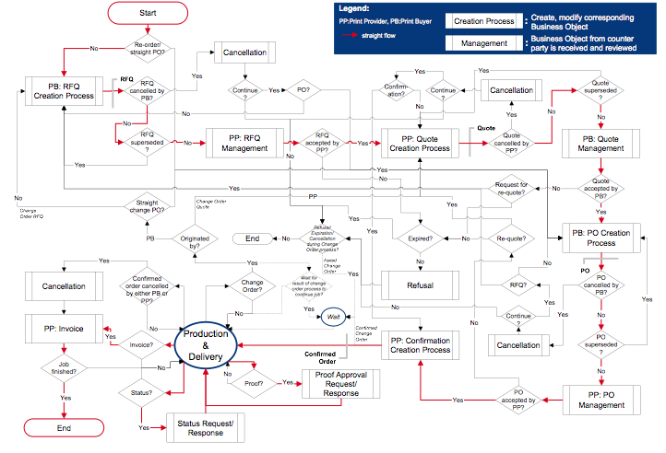
Flow Charts might Become Complicated
Notes:
Useful, but messy
Useful: every process can go wrong
Messy: Too much in the very beginning of setting un an automated workflow

Slide 16
Flow Charts might Become Scary

Slide 17
Process-Resource Models
Processes are described by verbs, resources are physical things, files or parameter sets
Processes normally have several input resources, i.e. prerequisites that are needed for running a process
Processes have one or more output resource(s), i.e. the result(s) that the process produces
A output resource of one process might be the input resource of the next process (a “transitional” resource)
Notes:
An abstract example of a Process-Resource Model
Resource
Physical: plates or paper
Virtual things: files, parameter sets, Bitmaps, Ink Zone Setting.
Rules for process-resource model
A process normally as several inputs (= prerequisites”
A process generates normally one output resource
Processes and Resources alternate
Transitional resource: output and input in the same time

Slide 18
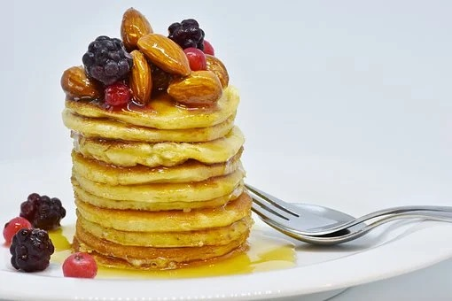
Process-Resource Model (PRM)
Let’s make
pancakes!
Sorry, let’s make a PRM recipe
Notes:
Think about processes and resources of pancake production

Slide 19
bowl
flour
_{1 cup}
whisk
baking
Powder
_{1 Tbls}
pan
_{Radius > 11 “}
stove
sugar
_{1/3 cup}
batter
pancake
mixing
frying
measuring
devices
milk
_{1/2 cup}
chef
yolk
beaten egg
white
oil
_{1 tbls}
chef
bowl
Kitchen
helper
beat
whisk
eggs
₂
egg white
separate
Process-Resource-Model for Pancake Production
Kitchen
helper
Notes:
Process resource model are not /unambiguous

Slide 20
Processes and Resources Must be Specified
If you want to replace the “chef” by a “mixing robot”, a “frying robot”, a “separating robot” and a “beating robot” a precise specification for all processes and resources is needed, which…
…must be clear, unambiguous, universal (not for pancakes only!) and represents a complete “language”
…should be an open standard – otherwise the pancake manufacturers cannot buy robots from different vendors
The specification is the tricky part - and, of course, robots must understand the language and can execute the processes accordingly
Please Note: The PRM is just a model, just a description what to do (“recipe”) . It’s not the production!
Notes:
Automation: Get rid of the chef and kitchen helper. Replace them by robots
More general for cooking, not only pancakes

Slide 21
Example of PRM in Print
Production is described by a network of processes and resources
Each process is executable when all mandatory input resources are available and the production time window is reached
Transfer
Curves
Ink
Bitmaps
Imaged
Plates
Printed
Sheets
Image
Setting
Conventional
Printing
Plates
Paper
Notes:
Example of PRM for printing industry
A lot of resources are missing

Slide 22
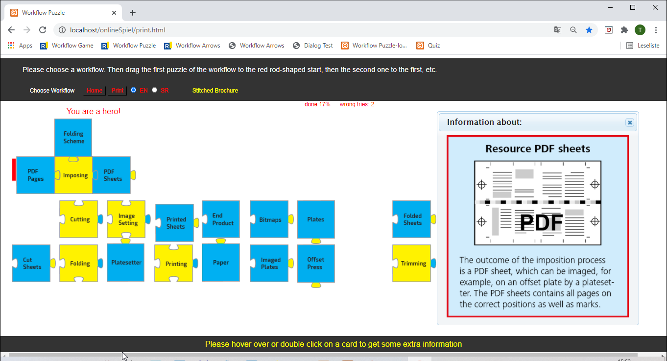
Model a print production workflow
https://www.torontomu.ca/~wdp/workflow-puzzle/print/print.html

Slide 23
JDF/JMF, XJDF/XJDF and PrintTalk
Job Definition Format (JDF), Job Messaging Format (JMF)
About 100 processes and 170 resources defined in JDF
JDF normally contains the workflow logic
JMF is the “SMS” for the printing industry. It allows dynamic interaction between the team players
Baby JDF: XJDF and XJMF
X stands for “Exchange”; XJDF simplifies JDF
Just a protocol between controller & devices; no workflow logic
PrintTalk
Defines business objects like RFQ, quote, confirmation, … ,invoice
PrintTalk can embed (X)JDF
Notes:
JDF specification is describing all processes and resources
Each print job has its own JDF
JDF gaining weight during print job handling

Slide 24
Metadata Communication Hub
PP’s Partners
PP Management
Customer
MIS
Paper Supplier
Job Scheduling
Plate Supplier
JDF
Reporting
XMP
JMF
Logistic Services
CFF2
DB
Preflight
PPF
private XML
Packing &Shipping
PJTF
Exif
Plate Making
XJDF
PrintTalk
Die Cutting
XJMF
CSV
Printing
Folding
Cutting
Stitching
Collecting
PP Processes
Industrial Digitalization ó Workflow Automation
Notes:
Circle represents a metadata hub, virtual hub
Spikes connect production processes, job management (MIS) and partners (customer and supplier)
Spikes between processes etc. and JDF data are bidirectional
Most important JDF, XJDF, PrintTalk
No need to know the metadata formats, data formats hidden under some GUI, but
Enhance/extend existing workflow
What’s under the hood

Slide 25
Information Exchange with JDF/XJDF
MIS
Page Size
Sheet Size
Colors
Printing substrate
Run length
Order information
(Imposition Scheme)
PostPress
PrePress
Note: The arrows symbolize logical addresses. However, most systems route the message through a controller, e.g. MIS
Ink zones presetting
Previews
Cutting positions
Folding positions
Press
Operational data
Notes:
Example of metadata exchange
How about backward direction for the arrows? Operational data for e.g. recalculation of job cost, production dashboards, digital panning boards

Slide 26
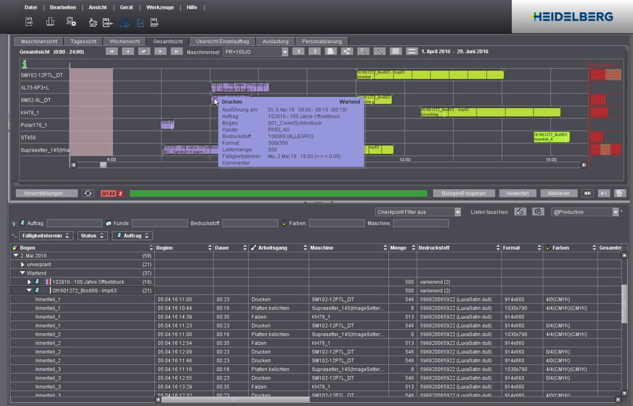
Planning Board – The Integration Champion
Notes:
Most complex example of integration
Current status of production devices
Print jobs (from MIS)

Slide 27
PRM for Prepress in Commercial Printing
MIS – Production Controller – Planning Board
PDF
pages
PDF
pages
PDF
pages
PDF
pages
Preflight &
optimizing
Colour
conversion
Trapping
Page
assigning
Sheet
layout
Defining
sheet layout
Plate
Bitmap
PDF
sheets
PDF
pages
Imaging
RIPing
Imposition
Notes:
Example for processes and resources in Prepress: starting with PDF pages from PB
Black arrows are logical communication paths
Chart might lead to misunderstanding: Resources are processes are normally not directly connected (MIS, production controller)
Red arrows in: Further resources like NodeInfo, params, material, equipment
Red arrow out: Further entries in the AuditPool of the process node, JMF signals
Note: No proofs and approval in this chart!

Slide 28
Inside of JDF: Hierarchy of JDF Nodes
Typically, MIS initializes a JDF for each print job
A JDF-Job is defined by :
Product nodes
Process group nodes
Process nodes
JDF nodes are described by XML-elements and XML-attributes.
Encoding: <JDF Type=“…”>
“Arrows” between those elements represent JDF sub-nodes
Notes:
Here you can see the just tree structure of JDF. As usual in computer science, the root is shown above and the leaves below. The tree is so upside down. I leave it to you to judge if this says something about the state of mind of computer scientists.
You still see, at the top are the product nodes. The deeper the hierarchy is, the more accurate the description of what the product should look like. How individual product parts of processes are to be executed is described in the process node. Some of those are previously grouped together in process groups nodes. The product node in the second line on the left creates the inside pages of a printed product. Then the underlying process groups could symbolize trapping, digital montage, exposure on a CtP system, printing, and so on.
Each node shown here is described by XML elements and XML attributes. We'll show you example of this soon. But also references between the nodes are possible and allow nodes to be used multiple times. Finally, the so-called resources are mentioned. Resources can be things like plates, movie, spreadsheet, color, etc. But also content files or device settings are called resources. The nodes of a tree can have references to the resources. For example, process nodes can define resources as input or output of their action.

Slide 29
Location of Resources
Nodes can also contain resources
Since some resources are used by several processes the resources are not necessarily in the JDF node that refers to them as input or output
Copies of resources should be avoided
Other means of defining which is an resource of a node: ResourceLink
Thus:
The Resource can be (almost) anywhere in any JDF node
The ResourceLinks in a JDF node define the reference (via ID) to the resources for the node.
Notes:
Here you can see the just tree structure of JDF. As usual in computer science, the root is shown above and the leaves below. The tree is so upside down. I leave it to you to judge if this says something about the state of mind of computer scientists.
You still see, at the top are the product nodes. The deeper the hierarchy is, the more accurate the description of what the product should look like. How individual product parts of processes are to be executed is described in the process node. Some of those are previously grouped together in process groups nodes. The product node in the second line on the left creates the inside pages of a printed product. Then the underlying process groups could symbolize trapping, digital montage, exposure on a CtP system, printing, and so on.
Each node shown here is described by XML elements and XML attributes. We'll show you example of this soon. But also references between the nodes are possible and allow nodes to be used multiple times. Finally, the so-called resources are mentioned. Resources can be things like plates, movie, spreadsheet, color, etc. But also content files or device settings are called resources. The nodes of a tree can have references to the resources. For example, process nodes can define resources as input or output of their action.

Slide 30
Sequential Architecture
MIS
Imposition
Ripping
CtP
Imaging
A single JDF file per job passes from one JDF module to the next e.g., via hot folder
No database, original concept, somehow outdated
JDF “gains weight” during production
In reality, processes are not sequential
overlaps (pipes), parallelism (data consistency)
Quite complex if level of JDF-integration is high
Difficult to maintain de-central data storage
Notes:
See Slide L04

Slide 31
Central JDF Storage For All Modules D₁,…,D₆
Some software is in charge for w/r of JDF, e.g., MIS
Processes may not use/update JDF data at the same time
Spawning&merging: A JDF part rw-spawned only once at a time
Nevertheless: Each module must be prepared to extract JDF nodes it needs from entire job ticket
D₁
Spawning
Merging
<?xml version="1.0" encoding="UTF-8" ?> - <JDF xmlns="http://www.CIP4.org/JDFSchema_1_1" CommentURL="file://prinance/PRINANCE/JDFConnector/Auftragstasche-HTML/07-0111.htm" DescriptiveName="Zuständ
D₆
D₂
<?xml version="1.0" encoding="UTF-8" ?> - <JDF xmlns="http://www.CIP4.org/JDFSchema_1_1" CommentURL="file://prinance/PRINANCE/JDFConnector/Auftragstasche-HTML/07-0111.htm" DescriptiveName="Zuständ(Creator:Pnc_V02.00.00.12a fuer Prinance 4.60)" Author="Administrator" ID="Link78056484_002163" TimeStamp="2007-11-27T16:40:56+01:00" CustomerID="12201" CustomerJobName="Zustände-WS0708" DescriptiveName="HdM"> <ContactRef
Creator:Pnc_V02.00.00.12a fuer Prinance 4.60)" Author="Administrator" ID="Link78056484_002163" TimeStamp="2007-11-27T16:40:56+01:00"
Creator:Pnc_V02.00.00.12a fuer Prinance 4.60)" Author="Administrator" ID="Link78056484_002163" TimeStamp="2007-11-27T16:40:56+01:00"
Creator:Pnc_V02.00.00.12a fuer Prinance 4.60)" Author="Administrator" ID="Link78056484_002163" TimeStamp="2007-11-27T16:40:56+01:00"
JDF
Status="Available" Street="Nobelstraße 10" /> - <Contact Class="Parameter" ContactTypes="Administrator
D₅
D₃
Status="Available" Street="Nobelstraße 10" /> - <Contact Class="Parameter" ContactTypes="Administrator
CustomerID="12201" CustomerJobName="Zustände-WS0708" DescriptiveName="HdM"> <ContactRef
D₄
JDF
document
JDF part
Modified
JDF part
JDF document
with modification
Notes:
Spawning & Merging for r/w

Slide 32
(X)JDF is just a communication protocoll
DB
DB
MIS
Production
Controller
Device 1
Device 4
Device 2
Device 5
(X)JDF, (X)JMF
Device 3
Device 6
Private DB access

Slide 33
XJDF – The simplified JDF
JDF is designed to contain information for the entire production
JDF node tree, resources, ResourceLinks, …
This leads to quite complex data structures
Moreover, such description is often stored additionally in private data bases of MIS or production controller
XJDF does not contain the entire workflow logic
It is merely an interface protocol between a production controller and specific devices
Easier to implement, less costly – especially for the devices
Workflow logic is stored in private data bases of controller
Notes:
What wwe learned so far:…
XJDF is new version of same idea

Slide 34
Comparison JDF - XJDF
XJDF Data for Dev. 1
JDF Data
JDF Data
XJDF Data for Dev. 2
JDF
XJDF
JDF Data
.
JDF Data
JDF Data
JDF Data
JDF Data
Device 1
JDF Data
New JDF Data
Device 1
Device 1
Device 1
Device 2
Device 2
Device 2
Private Data Base
Device 2
JDF Data
JDF Data
New JDF Data
JDF Data
New XJDF Data Dev. 1
JDF Data
DB
NewJDF Data
New JDF Data
New XJDF Data Dev. 2
JDF Data
Workflow Controller
Main technical advantages of XJDF to JDF
Devices need not to extract relevant data from the job ticket
Data bases are handling data update – no need for extra mechanism (spawn & merge) as with JDF
One XJDF node only with XJDF, no node tree, no ResourceLinks

Slide 35
PrintTalk
PrintTalk® is a CIP4 protocol that handles business aspects in the graphic arts industry
Main application area is the interface PB - PP
PrintTalk is used in the background for example by
Web-to-Print systems
Customer portals
Moreover, PrintTalk is deployed by MIS – MIS and by MIS – WMS communication
E.g., between subsidiaries of a print shop
PrintTalk is XML based
The root element of a PrintTalk document is <PrintTalk …>

Slide 36
Lab Work: EasyXJDF Hands on I
Download EasyXJDF from CIP4.org
See Tools & Libraries
For Mac take dmg file
Open the dmg file on Macintosh
Control & Open
Fill entries in GUI with whatever you like
Choose PDF as content
“Save as …”
Unzip and open the ptk file with XML editor or any dumb text editor and…

Slide 37
Lab Work: EasyXJDF Hands on II
… answer the following questions:
What is the type of PrintTalk Business Object?
What is he DescriptiveName of the XJDF job?
How many Products are in the ProductList?
How many Intent elements do you find?
What are the names of the Intent elements?
How many ResourceSets do you find in the file?
What are the names of the ResourceSets?
Notes:
Mount “EasyXJDF-Antwerp-20.03.dmg”
In the Finder on your Mac, locate the app you want to open.
Don’t use Launchpad to do this. Launchpad doesn’t allow you to access the shortcut menu.
Control-click the app icon, then choose Open from the shortcut menu.
Click Open.
The app is saved as an exception to your security settings, and you can open it in the future by double-clicking it just as you can any registered app.

Slide 38
Outcome of EasyXJDF - 1
<ptk:PrintTalk version="2.0" payloadID=“…" Timestamp="20190327T16:44:40Z">
<ptk:Request>
<ptk:PurchaseOrder BusinessID="4711">
<xjdf:XJDF Category="Web2Print" DescriptiveName="Industry 4 0 and JDF“ JobID="4711" Version="2.0">
<xjdf:GeneralID IDValue="42" IDUsage="CatalogID"/>
<xjdf:ProductList>
<xjdf:Product Amount="2222">
<xjdf:Intent Name="MediaIntent">
<xjdf:MediaIntent MediaQuality="Lumisilk 120"/>
</xjdf:Intent>
<xjdf:Intent Name="ColorIntent">
<xjdf:ColorIntent>
<xjdf:SurfaceColor NumColors="4" Surface="Front"/>
<xjdf:SurfaceColor NumColors="0" Surface="Back"/>
</xjdf:ColorIntent>
</xjdf:Intent>
<xjdf:Intent Name="LayoutIntent">
<xjdf:LayoutIntent FinishedDimensions="566…. 651…. 0.0"
PrintedPages="1" Sides="OneSided"/>
</xjdf:Intent>
</xjdf:Product>
</xjdf:ProductList>

Slide 39
Outcome of EasyXJDF - 2
< <xjdf:ResourceSet Name="CustomerInfo">
<xjdf:Resource ID="CustomerInfo_c799d2eb-1377-45da-8679 …">
<xjdf:CustomerInfo CustomerID="MickeyMouse"/>
</xjdf:Resource>
</xjdf:ResourceSet>
<xjdf:ResourceSet Name="RunList">
<xjdf:Resource ID="RunList_0ba58ec1-3093-4c0e-ae44-e38 …">
<xjdf:RunList>
<xjdf:FileSpec URL="asset/JDF Specification 1.7.pdf"/>
</xjdf:RunList>
</xjdf:Resource>
</xjdf:ResourceSet>
</xjdf:XJDF>
</xjdf:XJDF>
</ptk:PurchaseOrder>
</ptk:Request>
</ptk:PrintTalk>

Slide 40
Summary
(X)JDF most important metadata in print production
They are based on the Process Resource Model
They define the product intent and the production processes via their input and output resources
They contain information only, not the specifics how the information is used and distributed. They fuel the automation, but they don’t execute the automation.
XJDF is a simplified version of JDF. It does not contain the entire workflow logic
Both formats are used in parallel
PrintTalk defines the business workflow of a print provider and print buyer
Notes:
JDF and XJDF have a lot of things in common

Slide 41
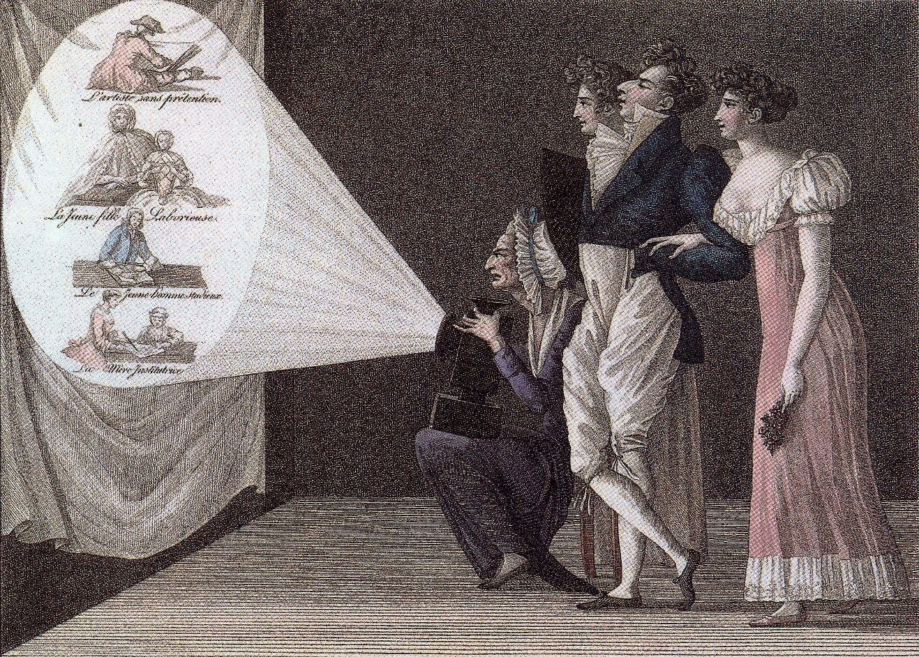
Thank you for your attention!
hoffmann@hdm-stuttgart.de

